Slide 2
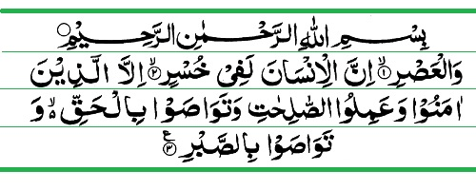

Slide 3
Husein Sugar Mills Ltd
Corporate Briefing Session
For the Year ended 30 September 2019.

Slide 4
Introduction:
Husein Sugar Mills Limited (“the Company”) is a public limited company incorporated in Pakistan.
The shares of the Company are listed on the Pakistan Stock Exchange Limited.
The Company is principally engaged in the production and sale of white crystalline sugar & its by products.
Its registered office is situated at 180-Abu Bakar Block New Garden Town, Lahore.

Slide 5
Husein Sugar Mills Ltd
Corporate Identity
Incorporation : 14 February,1966
NTN NO : 0225961-3
Sales Tax No : 04-041703-001-82
PSX Symbol : HSM

Slide 6
Husein Sugar Mills Ltd
Geographical Presence:
Export of Sugar
 | FY-2018-19 |  |  | FY-2017-18 |  |  | FY-2016-17 |  |  | FY-2015-16
Country | Qty/Ton | Value in Rs |  | Qty/Ton | Value in Rs |  | Qty/Ton | Value in Rs |  | Qty/Ton | Value in Rs
AFGHANISTAN | 10,268 | 470,945,815 |  | 2,930 | 113,547,918 |  | 14,654 | 769,521,652 |  | 7,067 | 333,175,560
Canada | 40 | 2,072,000 |  | 120 | 4,500,610 |  | 20 | 891,515
Tajikistan | 8,843 | 408,337,079 |  |  |  |  |  |  |  | 1,040 | 49,036,363
Total | 19,151 | 881,354,894 |  | 3,050 | 118,048,528 | # | 14,674 | 770,413,167 |  | 8,107 | 382,211,923

Slide 7
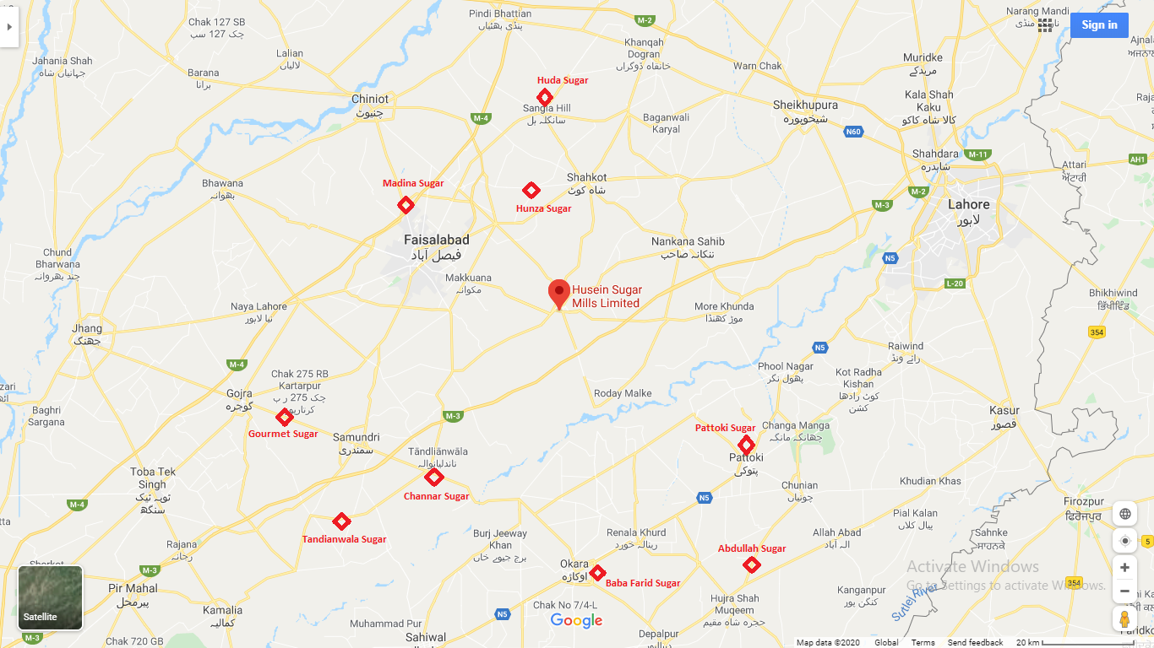
Our Location

Slide 8
Husein Sugar Mills Ltd
Our History
The company was incorporated on February 14, 1966 under the Companies Act 1913 (Now Companies Act 2017) as a Public Limited Company.
In 1967 The company was listed on the Karachi Stock Exchange.
In 1970 The Company achieved highest number of days of crushed.
In 1971 The company was listed on the Lahore Stock Exchange.
In 1982 Mian Muhammad Ali Tariq joined as Director of the Company.
In 1991 The company achieved Merit Certificate from Karachi Stock Exchange.

Slide 9
Husein Sugar Mills Ltd
Our History
In 1998 The Company achieved highest crushing ever.
In 2008 The Company announced 17% cash Dividend to Members.
in 2015 New Management takes over the Company.
In 2017 Company celebrated its Golden Jubilee.Highest Recovery of Sugar 9.85%. and record sugar Production is achieved

Slide 10
Husein Sugar Mills Ltd
Our Products
White Refined Sugar.
Molasses.
Bio-Fertilizer.
Bagasse.

Slide 11
Husein Sugar Mills Ltd
Current Development.
The Company has recently initiated an efficiency improvement scheme in which following major equipments/machines have been purchased and installed.
Purchase of 4 No,s of Mill max from Qadbros with the Loan of Rs 200.00 million from National Bank of Pakistan.
Purchase of 6MW steam Turbine with the Loan of Rs 75.00 million from Orix Modaraba.
Set up of 80 Ton Boiler with 23 Bar Pressure financed by FCIBL Rs 100.00 Million.
Falling Film Evaporators with the help of internally generated funds.

Slide 12
Husein Sugar Mills Ltd
Awards & accolade:
Best performance based award within 25 Companies in 1988.
Best performance based award within 25 Companies in 1990.

Slide 13
Husein Sugar Mills Ltd.
Current challenges & achievements:
 | 2018-19 | 2017-18 | 2016-17 | 2015-16
Paid Up Capital | 360,000,000 | 250,000,000 | 250,000,000 | 170,000,000
reserve Arising as a consequence of scheme of arrangement |  | 9,671,000 | 9,671,000
Reserve Arising as a consequence of scheme of arrangement | 70,694,859 | 70,694,859 | 70,694,859
Share premium account | 141,093,550 | 141,093,550 | 141,093,550 | 21,093,550
General Reserve |  | 169,450,000 | 169,450,000 | 169,450,000
Accumulated Profit|(Loss) A/C | 102,944,970 | (415,938,796) | (511,119,452) | (770,789,210)
Share deposit money |  |  |  | 609,681,833
Director, Loan | 446,380,983 | 530,351,753 | 531,851,753
 | 1,121,114,362 | 755,322,366 | 661,641,710 | 199,436,173
Surplus on revaluation of Fixed Assets | 1,726,506,614 | 1,777,492,862 | 1,822,091,754 | 1,453,548,580
Total Equity | 2,847,620,976 | 2,532,815,228 | 2,483,733,464 | 1,652,984,753
Current Ratio | 0.932 | 0.776 | 0.596 | 0.447

Slide 14
Husein Sugar Mills Ltd
Financial Highlights.
 | 2018-19 | 2017-18 | 2016-17 | 2015-16
Quantitative Data (M.Tons)
Cane Crushed | 491,277 | 600,773 | 660,136 | 499,396
Sugar Produced | 48,251 | 55,331 | 65,024 | 46,861
Recovery% | 9.81% | 9.21% | 9.85% | 9.41%
Operating Days | 98 | 135 | 151 | 111
 | Rs(M) | Rs(M) | Rs(M) | Rs(M)
Sales | 3,715,573 | 2,755,737 | 3,856,539 | 3,144,147
Gross Profit | 240,082 | 259,095 | 485,320 | 245,551
Operating Profit | 74,514 | 71,923 | 286,354 | 68,130
Profit(Loss) Before Taxation | 313,185 | 32,792 | 228,853 | 98,257
Taxation | (19,642) | 2,376 | (27,263) | 17,408
Profit after Taxes | 293,542 | 35,168 | 201,590 | 115,665
Basic Earnings per share | 9.05 | 1.28 | 9.55 | 5.61
Total Assets | 4,640,997 | 5,137,459 | 3,732,920 | 3,139,121
Current Liabilities | 1,395,380 | 2,439,517 | 1,052,191 | 1,276,551
Capital Employed | 3,245,617 | 2,697,942 | 2,680,729 | 1,862,570
Ratios
Gross Profit ratio | 6.46% | 9.40% | 12.58% | 7.81%
Net Profit(Loss) Ratio | 7.90% | 1.28% | 5.23% | 3.68%
Current ratio | 0.932 | 0.776 | 0.596 | 0.447
Break up value of share | 87.53 | 86.11 | 90.22 | 32.21

Slide 15
Husein Sugar Mills Ltd

